Slide 1
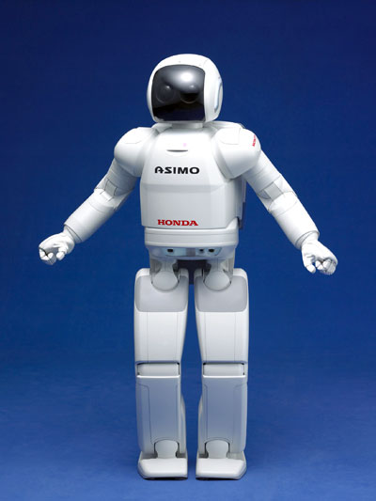
ASIMO Group 13
Advanced Step in Innovative MObility
ASIMO was created in 2000 by Honda.
Originally a project to analyse human two legged walking and its dynamic motion.
Currently a study on human behaviour and how certain aspects could be realised in a robot.
Now able to mimic human walking and running. Autonomous learning but still requires human assistance.
Not fully autonomous.
Safe interaction between humans and environment. Since creation ASIMO has gone from 26 degrees of freedom to 57.
Can understand English and Japanese. Able to interact with humans around it.

Slide 2
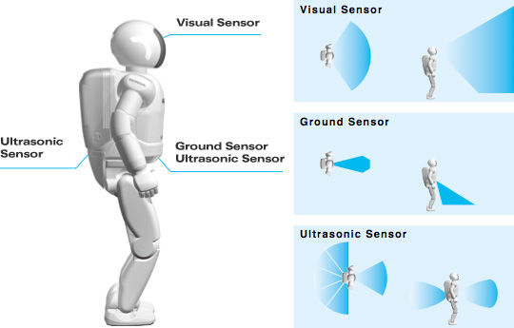
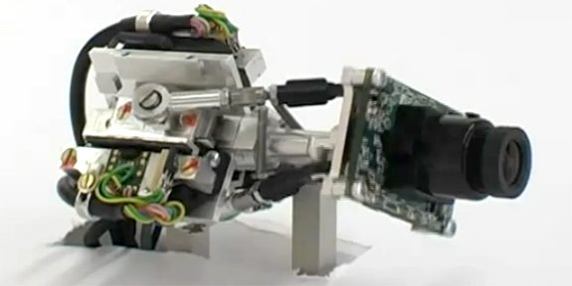
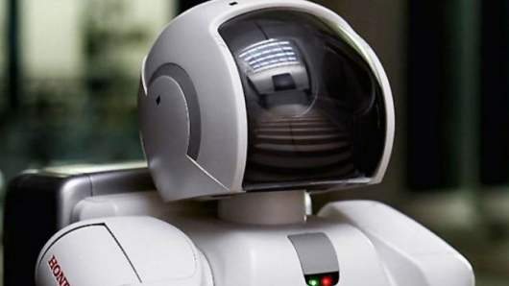
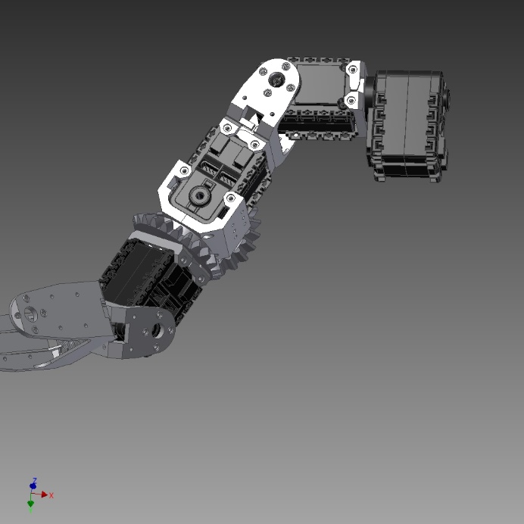
Camera
2 cameras
Remembers faces
Judges distance speed and direction of multiple objects
Microphones
5 microphones
Able to detect multiple commands at once
Notices its name and sharp sounds and turns to face them
Laser detection and infrared sensor
Detects objects on the ground surface in front of ASIMO in order to avoid obstacles.
Accelerometers and gyroscopes
Detects the centre of gravity of the robot
Twist torso whilst walking in order to maintain balance
Force Sensors
kinaesthetic force sensors
Fingers, wrist, knees and ankles
Detect magnitude and direction to react accordingly
Ultrasonic sensors
6 surrounding its stomach
3m range

